Slide 1
CANADEM
Integrated Risk Management Doctrine & Procedures
1. CANADEM has a high tolerance for operational risks
To provide greater utility for partners like UN, GoC, FCDO, etc. as CANADEM will accept certain risks that they need to transfer.
Successful management of substantial risk transferred from the UN, GoC and others has created a resilient organization confident in its Integrated Risk Management capacity.
2. CANADEM is fiscally cautious and financially risk-adverse
A CANADEM financial management principle is that almost always it is expending taxpayers’ funds, and thus has a public-sector fiscal responsibility to ensure sound financial management.
Having never had core funding, CANADEM is reliant on project funding that can be quite variable, a further incentive to be financially risk-adverse.
3. CANADEM practices Integrated Risk Management:
regularly assesses its current risk tolerance, e.g. the sufficiency of its operational reserve;
identifies and quantifies risks, then effects risk mitigation measures;
designates Primaries, activity teams, and organization-wide cohesion on how to identify and address risk;
manages risks events so as to avoid or limit actual harm.
Rev. Aug 2023
Notes:
CANADEM Risk - a possible future event that can substantially harm or benefit

Slide 2
CANADEM’s 3 Key Risk Sectors
see notes
Strategic
Risk
Operational
Risk
Financial
Risk
Notes:
Strategic Risk is the most important, because if there is not an excellent reason for doing something, why would we. We are not in the business of busy work, we are in the business of useful work.
Operational Risk is #2, because if we cannot make good things happen on the ground, then again, what are we doing.
Financial Risk is #3 and while a sine qua non (without which we cannot function for long), we are not in this for the money.

Slide 3

Three Risk Analysis Factors
#1 Likelihood
of risk occurring
e.g. 50%, 2%, 00.1% ?
#2 Impact
if risk occurs
catastrophic to simply annoying?
Level of Risk = Likelihood x Impact (part math and part intuition)
Level of Acceptable Risk
#3 Acceptability -comfort level with risk by board & staff
STOP?
or
GO?

Slide 4



Risk Assessment Process
restart the risk mitigation process
Is Inherent Risk Acceptable?
YES
NO
Risk is so unlikely and of such minor impact that no risk mitigation is necessary
Risk increases
or changes?
?
Accept
Risk
Monitor and Review Risk
1. Identify risk mitigation
2. Develop risk mitigation
3. Implement risk mitigation
Do NOT accept risk: end project, action, proposal, etc.
Is Residual Risk Acceptable?
That’s right, you can never get rid of all of the risk short of not undertaking a particular activity.
NO
YES

Slide 5
Integrated Risk Management (IRM) Informal Discussion Points
1. IRM procedures for the uninitiated can start to confuse, when in fact the basics are simple; 2. These discussion points are designed for individuals coming new to IRM.
There is no return without risk
Rewards go to those who take acceptable risks
Communicate and ask questions
Search out & openly discuss risks
Know what you don't know
Question your assumptions & adapt your actions
Use common sense and avoid ‘decidophobia’
Better to be roughly right than precisely wrong through inaction or a decision that is too late
One for all, all for one
Only integrated teams achieve integrated risk management.

Slide 6
Some Risk Mitigation Measures or Approaches
Prevention: e.g. stop or ban the activity
Reduction: e.g. limit the activity
Redundancy: e.g. back-ups, duplicate systems/equipment.
Controls: e.g. multiple sign-offs, check-lists
Transfer: e.g. by contract to transfer risk to consultants, insurers, etc.
Planning: e.g. contingency plans, operations gaming
Financial Reserves: e.g. ability to self-finance contingency actions
Training: e.g. individuals and teams trained for what might happen
*Risk Management is NOT the same as Crisis Management
This partial list of risk mitigation measures shows that risk management is systemic, constant, and a normal business activity.
Only very occasionally will risk events escalate into crisis management. So having frequent crises indicates either particularly bad luck or ineffective risk management to avoid crises.

Slide 7
CANADEM a Resilient Organization (based on staff capacity, not doctrine)
A key CANADEM value-added comes from being a resilient organization that
adapts well to risk,
learns from mistakes, and
can be relied upon to make it happen when dealing with:
External Risks: high awareness of its operating environment, able to identify changes in external risks, and dynamically reinventing procedures and strategies;
Unexpected Risks: Withstand unexpected sudden change and instantly adapt;
Internal Risks: Internally networked and self-aware so as to rapidly detect new internal risks or errors, and take immediate corrective action.
WHY?
CANADEM’s resilience in Integrated Risk Management comes from an empowered staff trained in 3 key CANADEM operational principles or attitudes:
Subsidiarity Principle of delegated authority
Primaries designated for all responsibilities
Team Culture including an all-of-CANADEM
360° alert & support approach , i.e. Integrated Risk Management.

Slide 8
Reason (HEAD) versus Feeling (GUT) Some Psychological Risk Identification Mistakes Read Risk: The Science and Politics of Fear by Dan Gardner
Lack of hard data to quantify a risk does not mean there is no risk
Familiarity breeds contempt – won’t happen to me.
Anchoring and Adjustment heuristic – we guess at level of risk using a recent number then adjust insufficiently
Calm informed analysis mitigates
partial facts and/or intuition and/or emotion
Availability Bias
“I remember a risk so it is more likely”
Some hard data does not mean that there is risk
“heard it on the news so it is more likely to happen”
Group Polarization
AKA group think: people with same perspective when in a group become more convinced and less open to new info
A ‘risk’ is not a risk just because someone has a gut feeling
SMART DECISIONS
Rule of typical things: some details are plausible therefore the whole scenario is likely
Law of Similarity
Appearance equals reality (“it walks like a duck”)
Confirmation Bias
We hear what we want…
to confirm what we already believe

Slide 9
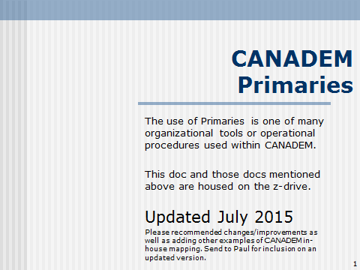
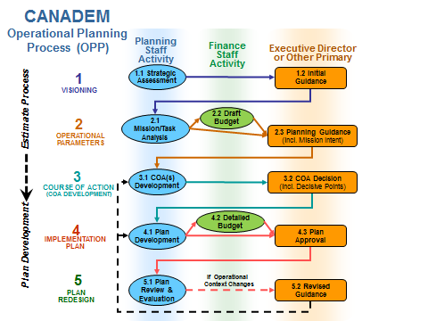
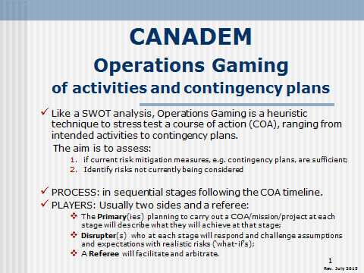
Remember other related CANADEM Procedures/Policies…
…such as

Slide 10
CANADEM Risk Management Roles & Responsibilities
Board: Strategic direction on risk tolerance and risk management.
Executive Director
Cultivate a culture of risk management, sensible risk taking, and team cohesion with all-of-CANADEM 360° alert & support as part of CANADEM’s Integrated Risk Management;
Ensure strategic risks are identified, assessed, and managed;
Operational Risk – can delegate yet ED retains ultimate responsibility for all risks.
Provide guidance on operational risk management;
Engaged by Primaries as required for operational risk management.
Division/Unit Heads
Ensure division/unit operational risks are identified, assessed, and managed;
Cultivate a culture of risk management, sensible risk taking, and team cohesion with all-of-CANADEM 360° alert & support.
All CANADEM Personnel
Stay informed on risk management issues related to their operational piece;
Accept risk as part of daily business & take prompt action as risk materializes.
Understand and implement all-of-CANADEM 360° alert and support
All-of-CANADEM 360° alert & support
A core CANADEM operational principle that every individual is key to effective Integrated Risk Management (IRM). Regardless of position, every individual is key to mitigating every CANADEM risk by alerting others if they perceive risks, and supporting others to manage risks.

Slide 11
Risk Assessment Matrix
Model matrix with some example risk events
IMPACT
 | Minor | Moderate | Major
Likely | moderate | high | critical
Possible | low | moderate | high
Unlikely | low | low | moderate
PROBABILITY
DFATD triggers advance work by CANADEM and then does not fund the project.
High maintenance deployee wastes our time
High maintenance deployee wastes (UN) mission’s time
Deployee misses flight or looses money, e.g. pick pocket
Deployee mugged or in minor car accident
Deployee killed or seriously injured
Money transfer blocked or delayed
strong negative audit comments
Project substantially over budget
personal information files hacked

Slide 12
Liability & Limiting Liability
Every organization and/or individual involved in an activity/project has liability of some sort, as determined by their:
Position or seniority;
Role or function; and
Reasonable expectation of their capacity and possible action.
Liability can be partially limited through contractual relationships.
But courts are the final arbiter and will look to deny illegal or unfair liability-limitation by:
the more powerful in an unequal bargaining relationship; and/or
those in authority who should have been better informed, and who should have more effectively exercised their due diligence and duty of care.
Liability can never be fully limited.
Note that merely withdrawing from any activity will not avoid liability already incurred.

Slide 13
‘Org Chart’ of Liability for CANADEM Deployed Personnel (the CANPOL-Haiti I example)
command & control
finance/admin control
information / coordination link
resultant liability of some sort
GoC & other member states
START
CIDA $ / FAC oversight
UN DPKO
RCMP
UN MINUSTAH
CANADEM
CANPOL-Haiti
The 25 police experts themselves
Chef de mission
Coordonnateur admin/log
Cdn CIVPOL Contingent
Contingent Commander
Teaching Point: everybody has some liability! And we mean everybody!

Slide 14
‘Org Chart’ of Relative Liability for CANADEM Deployed Personnel CANADEM-CGSO Afghanistan May 2010
CANADEM
Board
GoC Ottawa
GoA
GoC HoA Afg
CANADEM Ottawa
Exec. Dir.
CANADEM
Roster Division
CGSO Director
CANADEM
Deployment Division
Deputy Director
CANADEM
Finance Division
Security Team Leader
Administration & Logistics Manager
Technical Advisors
TAs and the CGSO management team are consultants on contract to CANADEM whose operational authority can at times approximate management control, and CANADEM always retains contractual control.
MSU, guards, drivers
LES Locally Engaged Staff
Operational authority (ranging from staff to consultants)
Always results in liability of some sort, albeit to varying degrees
Working link between CANADEM-HQ and CANADEM-CGSO
Strategic Oversight
Coordination Linkages & Information Sharing
CANADEM CGSO Doctrine & Procedures 14
Notes:
14

Slide 15
Legal Liability …can CANADEM be sued?
So far not, but yes we can be sued.
The courts will decide if we have sufficiently met our duty of care.
They look at the actual events, but know that nobody can prevent every risk event, so the courts, barring laws or contracts* to the contrary, will apply the ‘reasonable’ person test:
Did CANADEM do everything that a ‘reasonable’ individual/agency would do to mitigate ‘reasonably’ likely events.
Can CANADEM prove (e.g. document) that we:
Identified all ‘reasonably’ likely risks, e.g. documented ops gaming; and
Have we legally (contractually*) transferred certain risks, e.g. through insurance, or to sub-contractors including consultants; and
For all remaining risks did we take ‘reasonable’ mitigating measures such as
a. Clear lines of authority & responsibility, with responsibilities set at the right level,
e.g. subsidiarity and primaries;
b. Risk and security analyses both initially, and then regularly reviewed/updated
c. Resultant contingency plans and procedures (SOPs), also regularly reviewed/updated
d. Sufficient training & information sharing with/between:
All individuals so that they can mitigate risk
Key staff so that they can mitigate risk and ensure that others are mitigating theirs.
* Contracts can inadvertently create liability that is greater than the ‘reasonable’ test applied by courts, so concise contracts may well be better than complicated contracts.

Slide 16
Balancing risk management documentation against achieving other pressing tasks/goals
CANADEM since 2002 has effected substantial operational risk management but without much documentation of that risk management. This has two key drivers:
Small team-minded staff where integrated risk management (IRM) is second nature;
Operational principles/practices such as primaries and subsidiarity that enable ad hoc risk management that is both sufficient and an optimum allocation of resources to fit the requirements of rapid response and tight budgets.
So CANADEM is confident that its Integrated Risk Management is being achieved.
Management & other Primaries are aware of and managing key strategic & operational risks; carrying out a risk assessments before making important decisions.
All CANADEM staff have an understanding of CANADEM risk management doctrine. They are empowered to take smart decisions incurring risks, mitigate those risks, and know that they have the backing of management if risks materialize.
But such confidence is a risk in itself, and since our risk management process is not substantively documented, perhaps CANADEM is deceiving itself?
One key mitigation is that CANADEM is self-aware of this risk of complacency and the need to further mitigate, e.g. IRM refresher training, or proactive ad hoc consideration of strategic and operational risk whenever there are key decisions or major events/trends
Notes:
* A primary has the responsibility to ensure that a particular activity/function is carried out. Often many others including some senior to the primary are involved in that activity and are responsible to the primary to carry out certain tasks and thus the primary must manage them. Primaries are key to effective risk management, e.g. provide early warnings of new threats or risks that are materializing.

Slide 17
Risk-Communication
Risk-communication can increased internal and external confidence by showing that:
CANADEM has a sound IRM (Integrated Risk Management) system;
has identified risks properly;
understands those risks; and
is taking sufficient mitigation measures.
Some risk-communication Myths and Realities
MYTH* | REALITY
Talking about risk will only alarm others. | Experienced outsiders know there are risks, and if well communicated by CANADEM, they will be reassured.
Risk is too complicated to explain to others. | IRM is based on common sense, and by using common language not techno-babble, CANADEM can explain CANADEM risk management to the public and other stakeholders.
Risk communications is the job of the communications people | Every CANADEM individual is part of IRM and can speak to their area of risk awareness and risk management. They may be the best spokesperson albeit with assistance and direction from senior management and communications people in order to retain a coherent CANADEM response.
* These myths stem from legitimate worries about risks inherent in any communications.
But silence when there should be communication and transparency is a mistake.
At the same time, like diplomacy, in some situations silence is the right risk mitigation.

Slide 18
Emergency! Crisis! Death?! A Risk Event & CANADEM Response
Despite proper and sufficient risk prevention, bad things will happen, what is called a risk event.
All staff should be aware of our current response protocols
When a risk event occurs, staff should immediately look at those protocols
See: CANADEM HQ Critical Incident Response Immediate Procedure:
Z-drive/DOCTRINE and other core CANADEM Documents/ CANADEM HQ Critical Incident Response Procedure.doc
Throughout initial and subsequent actions, the principles in order of priority are:
Best interests of the victim and their immediate family
Concern about other CANADEM staff/associates in the field
Advancing optimum CANADEM and/or mission mitigation measures
Addressing CANADEM liabilities and risks
Transparency with the media and public without infringing privacy issues.

Slide 19
CANADEM HQ Critical Incident Fan-Out August 2023 version
Contact Board
Call Paul
C-613-797-0211
Convene Response Team
Email all staff
YOU
Call Pantiwa
C-613-263-8881
Contact relevant mission individuals/mgmt/funder
Call Andrea (DoC)
IF EOM or SPU contact relevant individuals/mgmt./GAC
Call Zoe
C-819-790-7251
Put out initial press release
As per CANADEM’s Integrated Risk Management,
any CANADEM staffer hearing of a critical incident should:
assume that nobody else is aware of it; and
take immediate initiative and call Paul + Pantiwa + Zoe if EOM/SPU
(see CANADEM HQ Critical Incident Response Immediate Procedure on z-drive)/

Slide 20
Note to non-CANADEM
Of course, feel free to use this powerpoint, and adapt it for your use. We hope it is useful.
Try watching it in slide show mode, as some slides have animations that you might find useful, and can easily go to the Animation Pane to build in pauses if you are training.
CANADEM’s in-house powerpoint is more extensive.
If you are interested in contracting CANADEM to help you customize this presentation or provide training assistance, please contact
Paul.LaRose-Edwards@CANADEM.ca

Slide 21
END

